Slide 1


Department of Computer Science and Engineering
CS191P11 – IOT
PHARMACEUTICAL STORAGE MONITORING SYSTEM
Haresh M – 210701066 Hayagreevan V - 210701080

Slide 2
Abstract
This project explores the significance of effective storage monitoring in the pharmaceutical industry and investigates the transformative potential of IoT technology in addressing storage-related challenges. The integration of IoT technology into storage monitoring systems enables real-time data collection and intervention, facilitating improved product quality assurance, enhanced supply chain visibility, and streamlined regulatory compliance. This project encompasses the warehouses / dispensaries which monitor the environment conditions like temperature, humidity and light intensity using IoT devices kept at specified locations. This smart device orchestra is controlled by a microcontroller which sends out required data to the management system. When there is a deviation from normal conditions, the system is expected to notify the change so that the data is interpreted by the concerned authorities to enable them to take quick actions to preserve the medicines. It provides effectiveness in maintaining optimal storage conditions and preventing product spoilage. Further research and collaboration can maximize the benefits of IoT-enabled storage monitoring systems in the pharmaceutical industry.

Slide 3
Introduction
In the dynamic landscape of the pharmaceutical industry, ensuring the integrity and efficacy of pharmaceutical products throughout their lifecycle is paramount.
Deviations in factors like temperature, humidity, and light exposure can significantly impact product quality and safety.
The integration of advanced technologies becomes imperative to meet the rigorous standards and regulatory requirements governing pharmaceutical storage.
By leveraging IoT-enabled sensors and connectivity, stakeholders can proactively monitor storage conditions, detect deviations, and initiate timely interventions to mitigate risks.

Slide 4
Literature Survey
In [1], the study emphasises the importance of storage in a total drug control system . Proper environmental control (i.e., proper temperature, light, and humidity, conditions of sanitation, ventilation, and segregation) must be maintained wherever drugs and supplies are stored in the premises.
In [2], a study was conducted in medical facilities of southern Malawi about storage conditions and knowledge of medical personnel about medicine storage. The study showed that more than 50% of medical storage facilities don’t maintain temperature records and only around 70% personnel had proficient knowledge on medicine storage conditions.

Slide 5
Literature Survey
In [3], the study evaluates the effects of storage conditions on specific pharmaceutical parameters of powders such as britility, density, hardness and disintegration. The study showed that prolonged exposure to unfavourable conditions affects its physical qualities.
In [4], the effects of light and storage on vitamin E present in pharmaceutical products is studied. Study showcased significant reduction in quality of vitamin E in medicine based on concentration.

Slide 6
Problem Statement
Building a system that monitors temperature, pressure, humidity and exposure to UV light in medical warehouses or dispensaries and intimates the unfavorable condition of the environment and expiration of pharmaceutical products accordingly.
To create a pharmaceutical storage monitoring system with a real-time dashboard web application.
Objectives are developing hardware and software for data collection, analysis, monitoring and alerting, as well as designing a user-friendly web interface.

Slide 7
Proposed Work
The proposed work is an IOT enabled React based web application that utilizes NodeMCU for communication with the web application.
The data obtained from the sensors is stored in PostgreSQL database and is rendered to the frontend via React and MUI. The Express library hosts the server with the RESTFUL API to handle the data transfer requests and manipulation.
The main component used includes ESP8266-12E NodeMCU is connected to a collection of other sensors such as DHT11 for temperature and humidity and BH-1750 for Light Intensity which reads the data from the sensors and stores the sends it to the server.

Slide 8
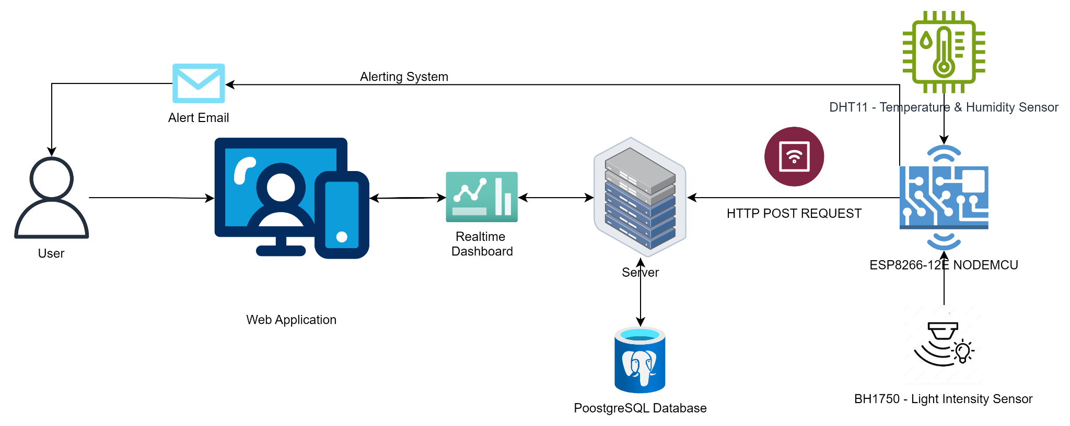
System Architecture

Slide 9
Methodology
HARDWARE MODULE : This module comprises temperature, humidity, and light intensity sensors along with the microcontroller (ESP8266-12E) for data acquisition. The sensors are responsible for continuously monitoring the environmental conditions in the pharmaceutical storage facilities.
DATA COLLECTION AND PROCESSING MODULE : Responsible for interfacing with the hardware module to collect real-time data from the sensors and storing the data into the database. Utilizes HTTP communication protocols to ensure accurate and reliable data transmission. Implements algorithms to analyze the data and identify deviations from predefined thresholds.
ALERTING MODULE : Monitors processed sensor data for any deviations from acceptable ranges. Triggers alerts (e.g., Email, Buzzer) to notify administrator when deviations are detected, ensuring timely intervention to prevent damage to pharmaceutical products.

Slide 10
Methodology
WEB APPLICATION MODULE : Develops a user-friendly web interface with a real-time dashboard for visualizing sensor data. Provides stakeholders with access to real-time monitoring of storage conditions, enabling remote management and decision-making along with Inventory Management of Pharmaceutical Storage Unit.
INTEGRATION MODULE : Integrates the data processing and alerting functionalities with the web application to ensure seamless communication and data display. Enables synchronization between the monitoring system and the dashboard for immediate updates.
EMAIL MODULE : Email module sends the email intimation to stakeholders daily to update them of the status of medicines stored in the database. Email intimation is sent to the user when there is change in the detected value from sensors that does not lie in the permitted range for the storage of specific medicines

Slide 11
Results and Discussion
This project can benefit the pharmaceutical industry. For the Pharmaceutical Industry, it will collect real-time data, analyze it for deviations, and trigger alerts if conditions exceed acceptable thresholds.
Key components include IOT sensor selection, software development for data analysis, providing real-time dashboard and alerting the management when there is an abnormality.

Slide 12
Conclusion
The pharmaceutical storage monitoring system with its real-time dashboard web application stands as a revolutionizing advancement in pharmaceutical storage management, ensuring the integrity and efficacy of stored medications. Future enhancements can be directed towards several key areas. Enhanced data analytics techniques can unlock deeper insights into storage condition trends, informing proactive management strategies. Predictive maintenance algorithms can be developed to anticipate equipment failures and ensure uninterrupted monitoring operations.

Slide 13
References
Shafaat, K., Hussain, A., Kumar, B., Hasan, R., Prabhat, P., & Yadav, V. (2013). An overview: storage of pharmaceutical products. World J Pharm Pharm Sci, 2(5), 2499-2515.
Khuluza, F., Chiumia, F. K., Nyirongo, H. M., Kateka, C., Hosea, R. A., & Mkwate, W. (2023). Temperature variations in pharmaceutical storage facilities and knowledge, attitudes, and practices of personnel on proper storage conditions for medicines in southern Malawi. Frontiers in Public Health, 11, 1209903.
Gbenga, B. L., & Taiwo, Y. (2015). Studies of the effect of storage conditions on some pharmaceutical parameters of powders and tablets. Dhaka University Journal of Pharmaceutical Sciences, 14(2), 147-151.
Nhan, P. P., & Hoa, N. K. (2013). Effect of light and storage time on vitamin E in pharmaceutical products. British journal of pharmacology and toxicology, 4(5), 176-180.

Slide 14
GitHub and Drive Links
GitHub Links :
https://github.com/hayagreevanv-rec/210701080-CS19P11-IOT-Lab
https://github.com/hareshm-rec/210701066-CS19P11-IOT-Lab

Slide 15
Thank You

